Slide 1
Capstone Project – 3 Classification
"Cardiovascular Risk Prediction” Presented By : Mr. Hasnain Mazhar Rizvi

Slide 2
Points of Discussion
Problem Statement
Data Description
Data Preparation and Cleaning
EDA (Exploratory Data Analysis)
Hypothesis Testing
Feature Engineering
Model Implementation
Model Interpretation
Conclusion

Slide 3
1. Problem Statement
Cardiovascular diseases (CVDs) are the major cause of mortality worldwide.
The dataset is from an ongoing cardiovascular study on residents of the town of Framingham, Massachusetts. The classification goal is to predict whether the patient has a 10-year risk of future coronary heart disease (CHD). The dataset provides the patients’ information. It includes over 4,000 records and 16 attributes. Each attribute is a potential risk factor. There are both demographic, behavioral, and medical risk factors.

Slide 4
2. Data Description
There are a total of 16 feature columns where 'TenYearCHD' is the dependent variable column. The total number of observations(rows) are 3390.
There are no duplicate rows in the dataset.
Also there are missing values in the columns education, cigs per day, BP meds, totChol, BMI, heart rate and glucose.
Sum of all missing Values are 510.

Slide 5
2. Data Description
Fields | Description
Sex | gender
Age | age
education | The level of education of the patient
is_smoking | Whether smoking currently or not
Cigs_Per_Day | Cigarettes smoked per day
BP_Meds | Whether taking BP meds or not
Prevalent Stroke | If the patient has a history of stroke
Prevalent hyp | If the patient has a history of hypertension
Diabetes | Patient has diabetes or not
Tot Chol | Cholesterol measure
Sys BP | BP measure
Dia BP | diastolic BP measure
BMI | Body Mass Index
Heart Rate | Heart Rate measure
glucose | glucose level
TenYearCHD | 10-year risk of coronary heart disease CHD

Slide 6
2. Data Description
Demographic:
Sex: male or female ("M" or "F")
Age: Age of the patient (Continuous - Although the recorded ages have been truncated to whole numbers, the concept of age is continuous)
Education: The level of education of the patient (categorical values - 1,2,3,4)
Behavioral:
is_smoking: whether or not the patient is a current smoker ("YES" or "NO")
Cigs Per Day: the number of cigarettes that the person smoked on average in one day.(can be considered continuous as one can have any number of cigarettes, even half a cigarette.)
Medical (history):
BP Meds: whether or not the patient was on blood pressure medication (Nominal)
Prevalent Stroke: whether or not the patient had previously had a stroke (Nominal)
Prevalent Hyp: whether or not the patient was hypertensive (Nominal)
Diabetes: whether or not the patient had diabetes (Nominal)

Slide 7
2. Data Description
Medical (current):
Tot Chol: total cholesterol level (Continuous)
Sys BP: systolic blood pressure (Continuous)
Dia BP: diastolic blood pressure (Continuous)
BMI: Body Mass Index (Continuous)
Heart Rate: heart rate (Continuous - In medical research, variables such as heart rate though in fact discrete, yet are considered continuous because of large number of possible values.)
Glucose: glucose level (Continuous)
Predict variable (desired target):
TenYearCHD: 10-year risk of coronary heart disease CHD(binary: “1”, means “Yes”, “0” means “No”)

Slide 8
3. Data Preparation and Cleaning
There are no duplicate rows in the dataset.
There are missing values in the columns education, cigs per day, BP meds, totChol, BMI, heart rate and glucose.
Changed the names of all the columns for ease of use.
I have also defined the continuous variables, dependent variable and categorical variables for ease of plotting graphs.

Slide 9

4. EDA (Exploratory Data Analysis)

Slide 10
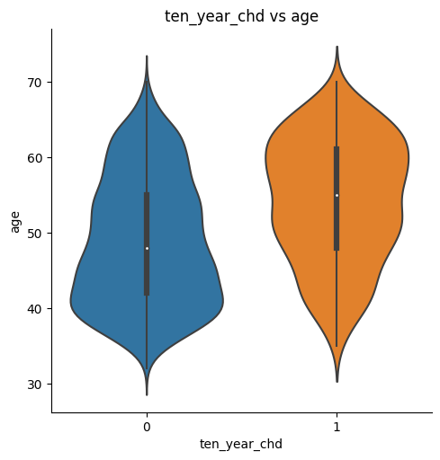
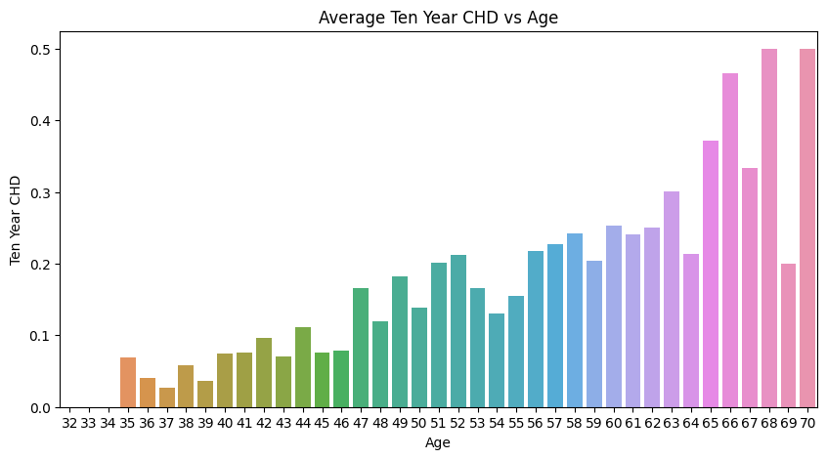
Ten Year CHD by Age
CHD probability is high for above 65+ aged peoples.
So, older people have a higher risk of having coronary heart disease in next 10 years.

Slide 11
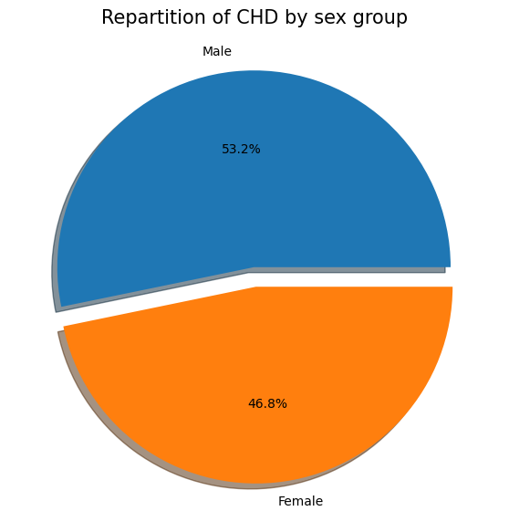
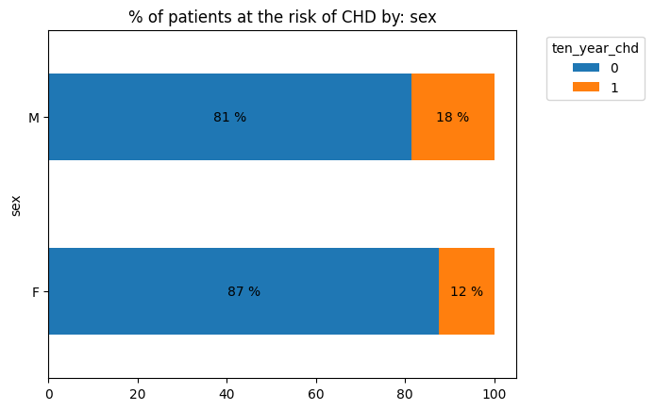
Ten Year CHD by Sex
The gender distribution is not even with high count for females. 53.2% are there for males and 46.8% for females.
Men are generally at a higher risk of having coronary heart disease.

Slide 12
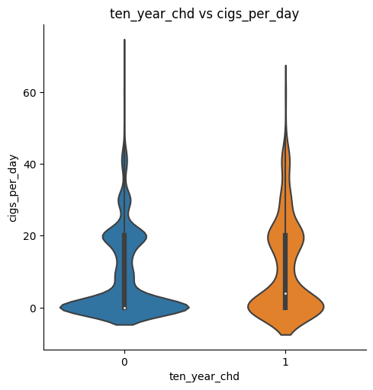
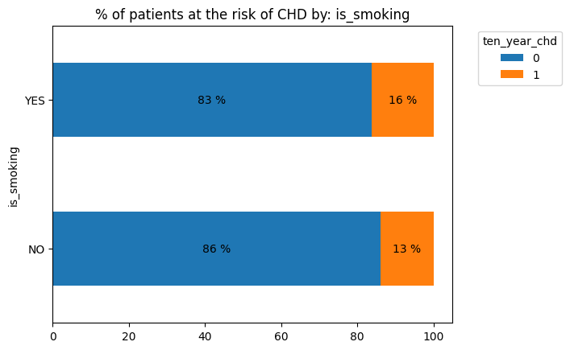
Ten Year CHD by Smoking
The negative cases are more for the non smokers compared to the positive cases for non smokers.
Statistically, 10 year risk of CHD is not dependent on smoking with a 95% confidence.

Slide 13
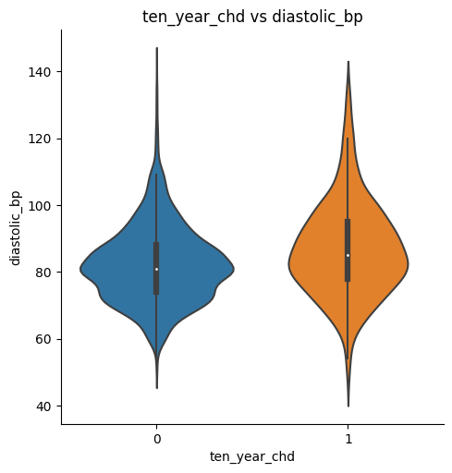
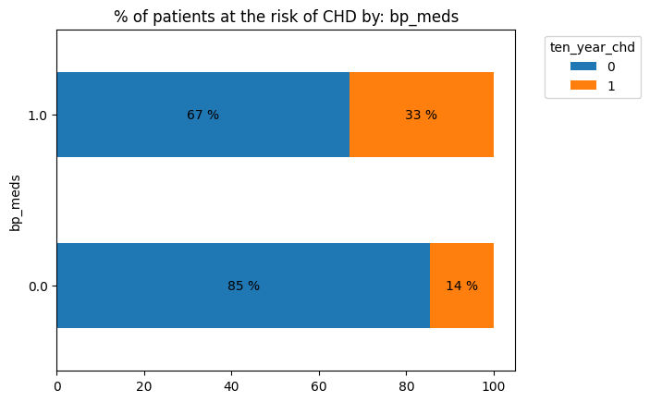
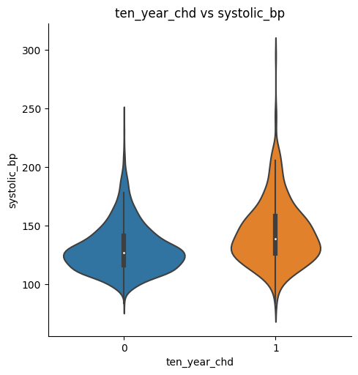
Other Notable Observations
Patients who have high blood pressure and have been taking BP medication have comparatively higher risk of CHD.

Slide 14
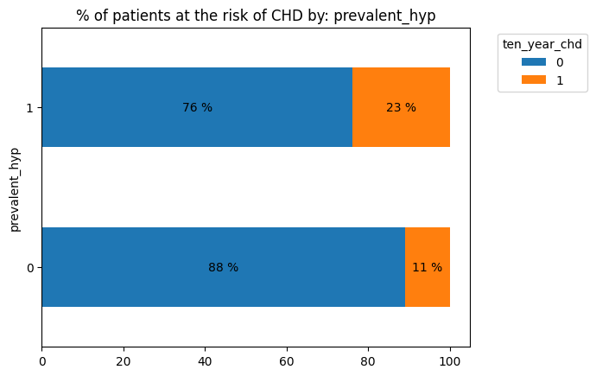
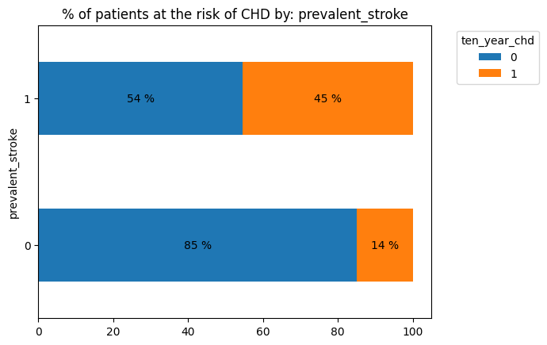
Other Notable Observations
Patients who have a history of hypertension and had a stroke previously have comparatively higher risk of CHD.

Slide 15
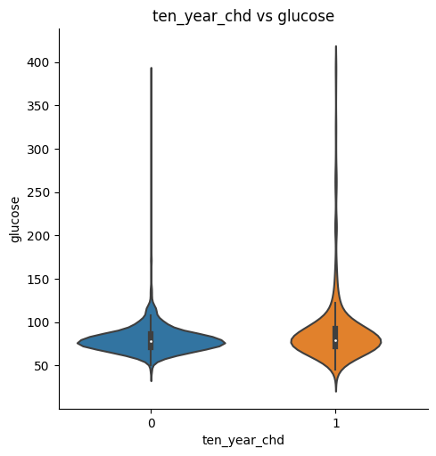
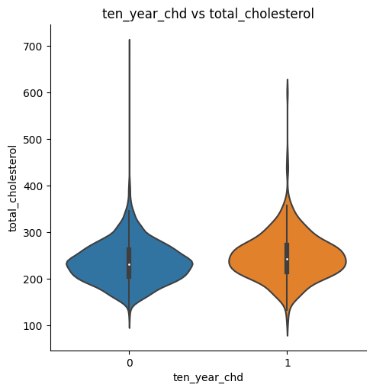
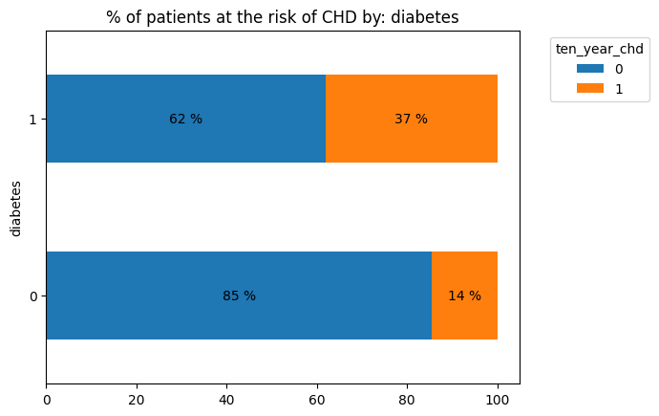
Other Notable Observations
Similarly, patients with high cholesterol and glucose level (with diabetes) have higher risk of having CHD.

Slide 16
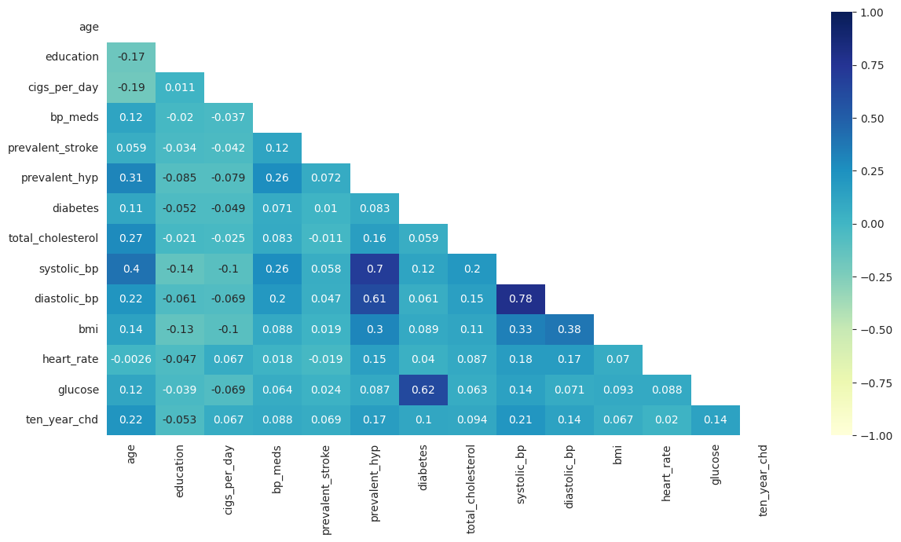
Correlation of features
There is a significant correlation between systolic BP and prevalent hypertension.
Similarly diastolic BP and systolic BP are highly correlated. Also glucose level and diabetes are correlated.

Slide 17

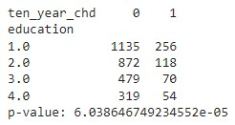
Hypothesis Testing
I choose the chi-squared test of independence to test the hypothesis that the ‘education’ column does not impact the outcome of chronic heart disease (CHD).
In this case, both education level and CHD outcome are categorical variables.
The p-value is significantly lower than 0.05 so we reject the null hypothesis.

Slide 18
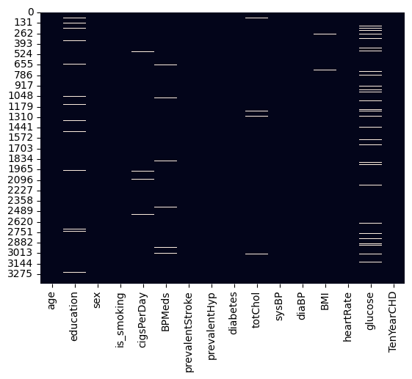
Feature Engineering
We Encounter some Missing Values so we have to handle it first. To fill up the absence of data in our categorical variables i have used simple imputer that imputes the null values with feature label that is most frequent in the feature column.
In continuous variables, i have used KNN imputer which uses a unsupervised clustering algorithm to come up with values of the features.

Slide 19
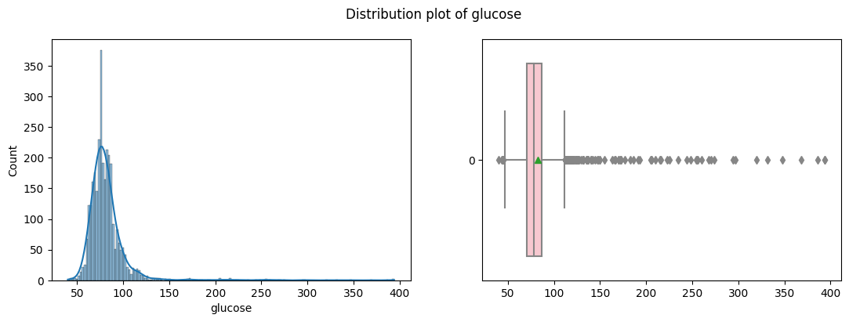
Feature Engineering
Handling Outliers
Used the Interquartile Range (IQR) method to identify and remove outliers in the continuous columns (systolic_bp, diastolic_bp, total cholesterol, glucose etc.) of the dataset.

Slide 20
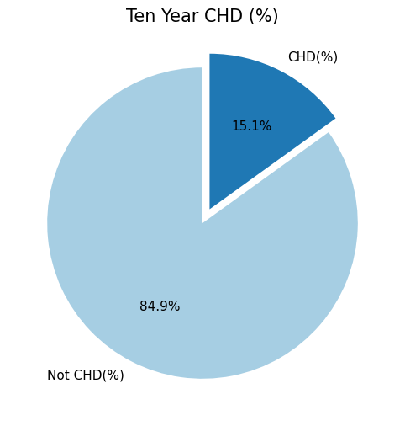
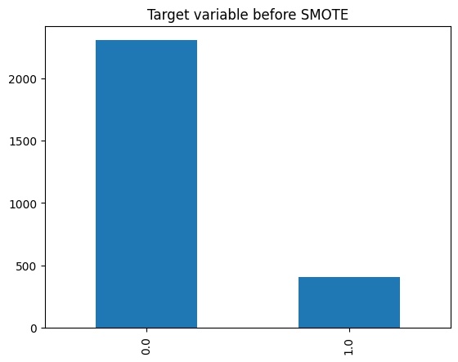
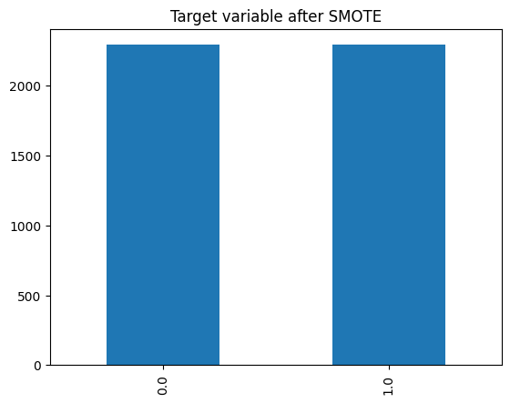
Feature Engineering
Handling Imbalanced Dataset
After splitting data into train and test sets with ratio 80:20, i have used SMOTETomek links to handle the imbalanced dataset.
By combining oversampling of the minority class with undersampling of the majority class, I was able to achieve a balanced dataset, where train set of size 4586 with 2712 samples of each of the class.

Slide 21
Model Implementation
Since we’re trying to predict continuous variable, I trained various classification algorithms along with hyperparameter tuning and cross validation to get the best model.
Logistic Regression
Decision Tree
Random Forest
Support Vector Machine
Xtreme Gradient Boosting
Naive Bayes
Neural Network

Slide 22
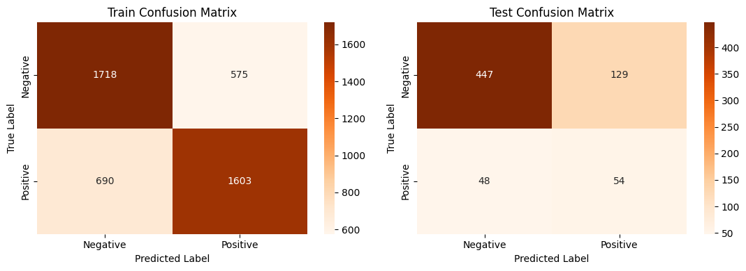
1. Logistic Regression
After Tuned

Slide 23
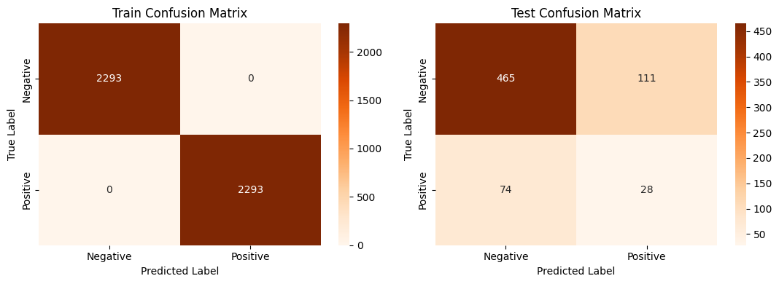
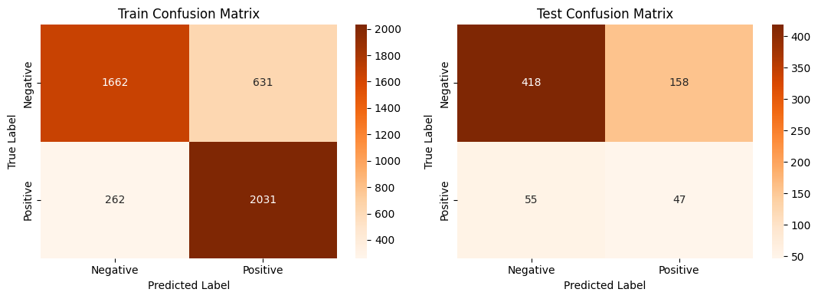
2. Decision Tree
After Tuned

Slide 24
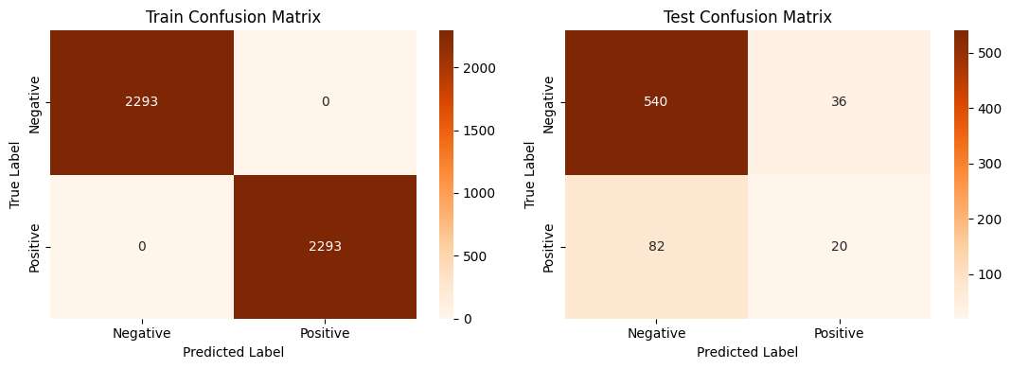
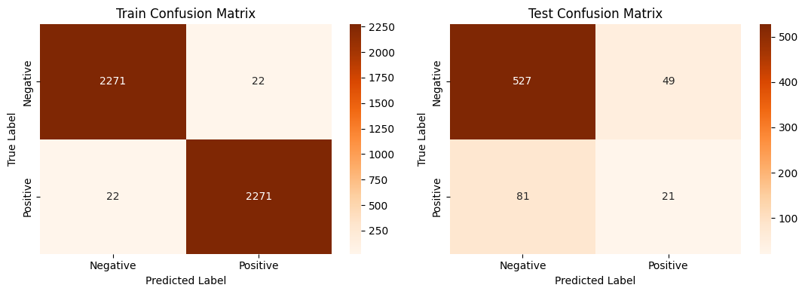
3. Random Forest
After Tuned

Slide 25
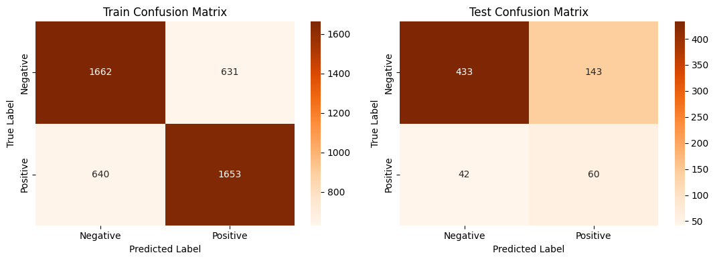
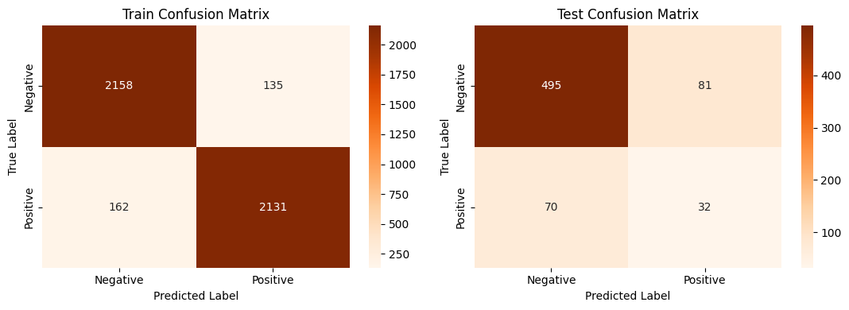
4. SVM (Support Vector Machine)
After Tuned

Slide 26


5. Xtreme Gradient Boosting
After Tuned

Slide 27
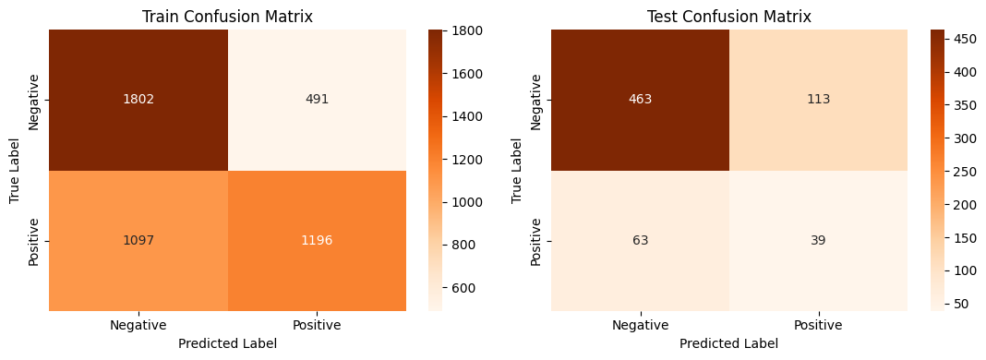
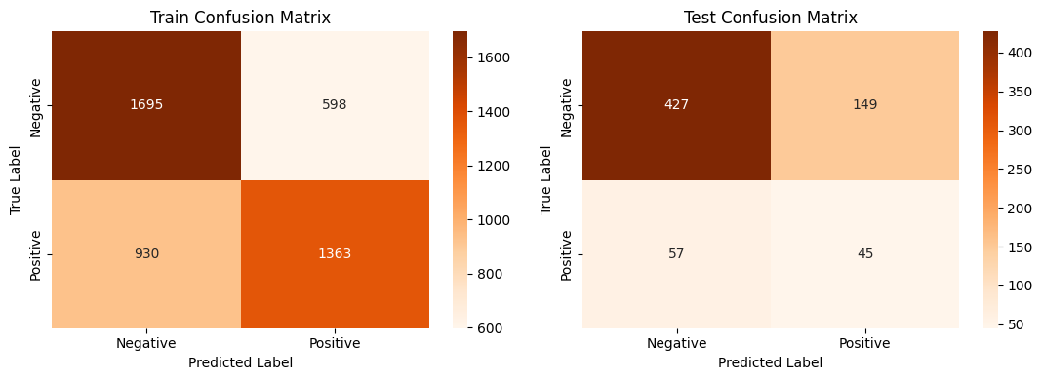
6. Naive Bayes
After Tuned

Slide 28
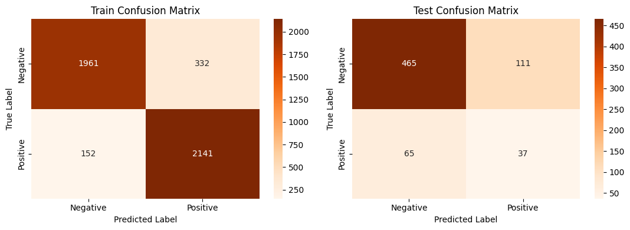

7. Neural Network
After Tuned

Slide 29
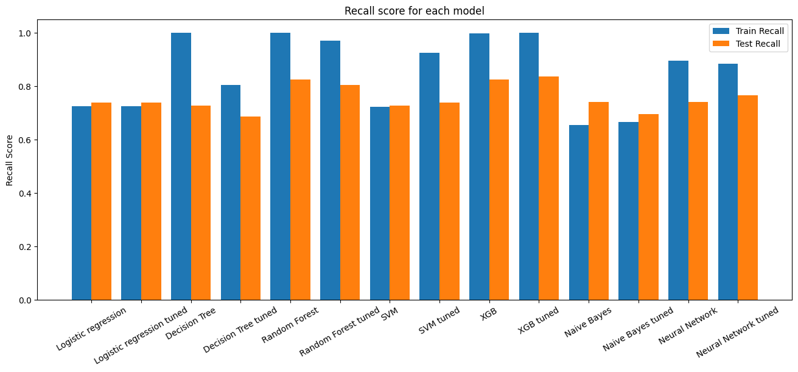
Selection of Best Model
Removing the overfitted models which have recall, ROC-AUC, f1 scores for train as 1.
Selected recall as the primary evaluation metric.

Slide 30
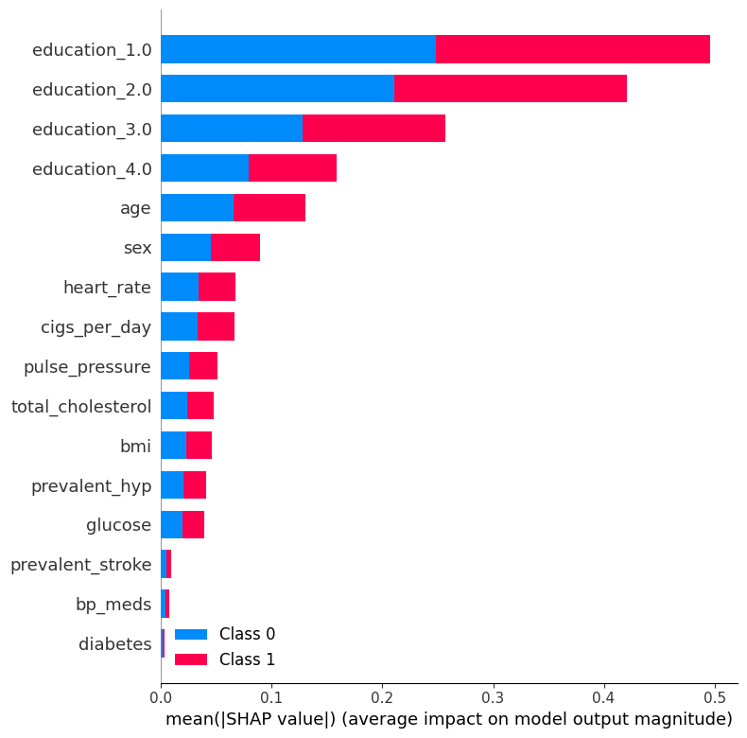
Model Interpretation
SHAP (SHapley Additive exPlanations)

Slide 31
Conclusion
The Neural Network model (tuned) was chosen as the final prediction model due to its high recall score compare to the other models.
Due to the presence of much missing/ null values in dataset, the accuracy is less. But, its ok because it not affects in life risk.

Slide 32
Thank You AlmaBetter!!!

